Slide 1

Research and Investment
Recommendations in the Utilities Sector
An Analytical Overview of India's Power Industry
Presented by: SANKALP KHAMKAR | Boston Institute of Analytics |
preencoded.png

Slide 2


Project Objective & Scope
Objective
Identify high-potential companies in Indian utilities sector
Scope Includes
Sector overview and key drivers
Power Purchase Agreements
Fuel source dependency
Financial health and risk
Valuation & investment recommendations
preencoded.png

Slide 3
Sector Overview & Market Dynamics
Sector Components
Electricity, water, natural gas providers
Dominance of generation & transmission
Regulated, capital intensive, govt. involved
Key Segments
Thermal (Coal & Gas)
Renewables (Solar & Wind)
Transmission infrastructure
Market size ₹15.7 lakh Cr (2024), 8% CAGR growth Regulatory drivers: RPOs & SEB reforms (UDAY)
preencoded.png

Slide 4
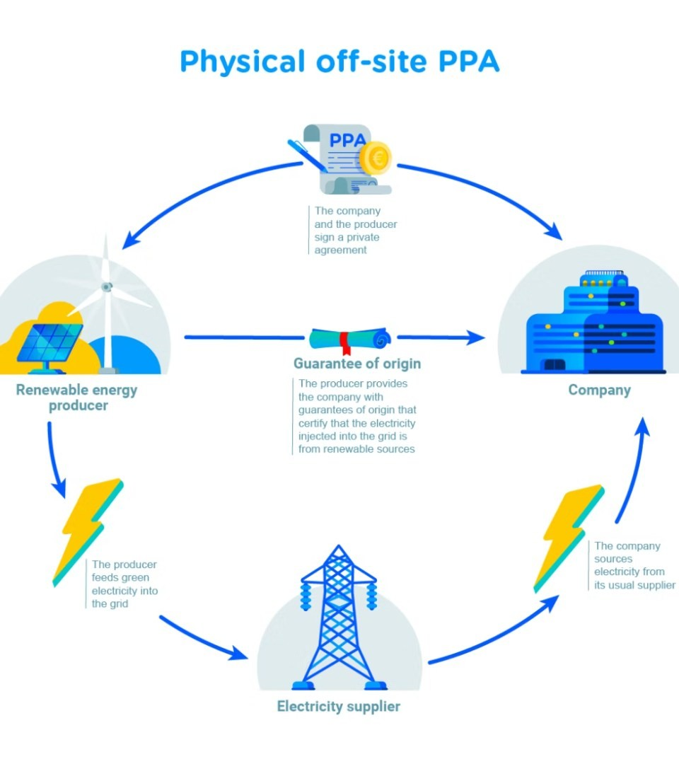

Power Purchase Agreements (PPAs)
PPA Types
Long-term fixed rate (low risk)
Spot/merchant sales (higher risk)
Renewable energy PPAs (growing)
Investment Importance
Revenue visibility
Reduces price volatility
Indicates operational stability
preencoded.png

Slide 5
Key Sector Drivers & Research Methodology
Sector Drivers
Shift to renewables (solar, wind)
Project pipeline & government clearances
External factors: policy, elections, global trends
Research Methodology
Data collection: Financials, SEB health
Financial analysis: P/E, ROE, Debt ratios
Risk scoring: Fuel, SEB, PPA exposures
preencoded.png

Slide 6


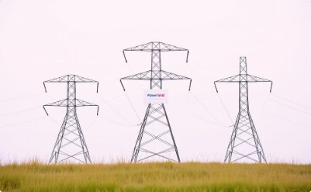

Top Indian Utilities Companies
Tata Power
70% renewable capacity by 2025,
$9B investment plan
Adani Green
14.2 GW portfolio, aims 50 GW by 2030, $3.6B capex FY26.
Power Grid
Largest transmission co., stable revenue, renewables integration.
JSW Energy
Diversified portfolio, ₹976.55 Cr revenue, ₹217.19 Cr net profit.
Recent Developments: Plans to invest up to $9 billion to expand renewable energy capacity. Dhan Blog+2Wikipedia+2Upstox - Online Stock and Share Trading+2Wikipedia+3Dhan Blog+3Upstox - Online Stock and Share Trading+3
Portfolio: Currently has a portfolio of 14.2 GW, aiming for 50 GW by 2030.Reuters
Renewable Integration: Expanding its role in renewable energy transmission. Dhan Blog+25paisa+2Appreciate Trading App+2Appreciate Trading App+15paisa+1
Financial Performance:
Reported a revenue of
₹976.55 crore and a net profit of ₹217.19 crore in December
2024. Appreciate Trading App+1Upstox - Online Stock and Share Trading+1Dhan BlogAngel One

Slide 7
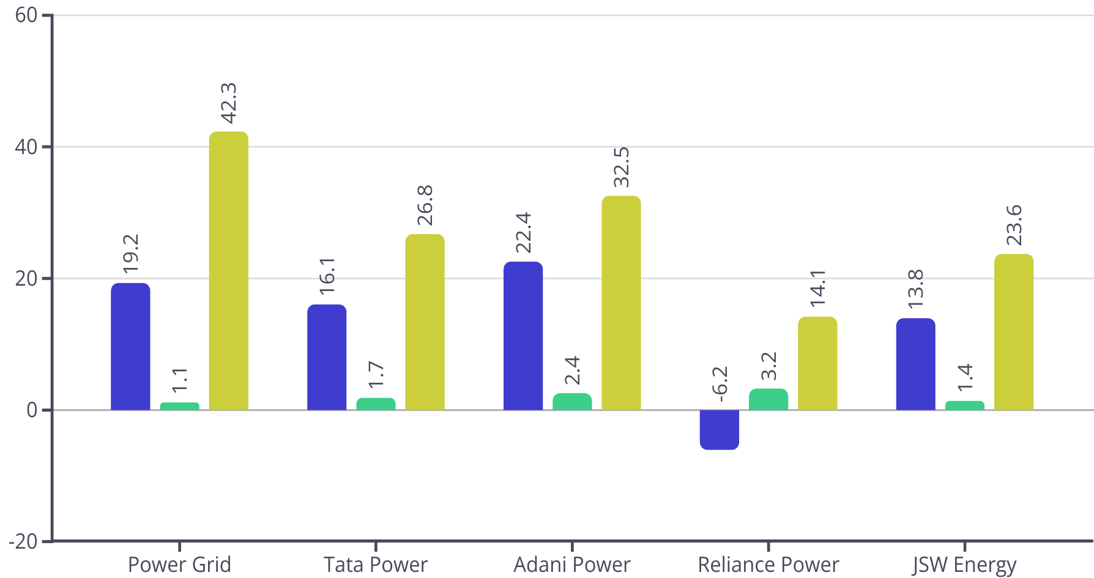



Financial Metrics Overview & Comparison
Adani leads in ROE at 22.4%, reflecting strong profitability.
Power Grid maintains lowest debt ratio at 1.1, indicating financial stability.
Power Grid also ranks highest in EBITDA margin at 42.3%, showing operational strength.
ROE %
EBITDA Margin %
Debt-to-Equity
preencoded.png

Slide 8
Company Risk Profiles & Sector Risks
Company Risk Profiles
Power Grid: Low risk, stable revenue via long-term PPAs
Tata Power: Moderate risk; diverse portfolio, partial fuel
hedging
Adani Power: High risk; reliant on imported coal, price sensitive
Reliance & JSW Energy: Very high risk; minimal PPAs,
regulatory uncertainty
Key Sector Risk Factors
Regulatory changes in state tariff policies
Coal price volatility affecting margins
Market fluctuations in energy demand and prices
Operational delays and maintenance challenges
Environmental regulation impacts, climate risks
SEB delays with ₹1.2 lakh Cr overdue payments
preencoded.png

Slide 9













Company Risk Profiles
Company | Fuel Risk | SEB Exposure | PPA Coverage
Power Grid | Low | Low | 97%
Tata Power | Moderate | Moderate | Partial
Adani Power | High | High | 68%
Reliance Power | Very High | Very High | Low
JSW Energy | Very High | Moderate | Partial
SEB overdues > ₹2,100 Cr for Reliance Power (2024)
preencoded.png

Slide 10
Profitability & Investment Recommendations
Net Profit Comparison (₹ Cr)
Power Grid: 10,450
Adani: 6,850
Tata Power: 4,320
Reliance Power: -1,240 (loss)
Investment Portfolio
50% Power Grid - Stable cash flows
25% Adani Power - High growth, risk tolerance 15% Tata Power - Renewables transition
10% Cash - Hedge SEB delays
preencoded.png

Slide 11

Conclusion & Next Steps
Summary
Power Grid: Best balance of growth & stability
Monitor Tata Power’s renewable
expansion
Key Data Sources
Power Grid Annual Report
Adani Power BSE Filing
ICRA Utilities Report
Final Call
Allocate 60% low risk, 30% growth,
10% cash reserves
preencoded.png

